Slide 1
Project Title: Smoke detector System Using Gas Sensor Course Code: BSD 3205
Unit: Embedded Systems Members:
Rose Maina -20/02855
Godfrey Maina -19/03627
Jonathan Kibet- 20/03840
Elly Aseneka-18/05352
Faith Chepkirui- 20/03485
Ruth Mwende -20/03285
Emmanuel- Oduor 20/03203
Basil Juma -20/04915
Alvin Maina -20/04372
Brian Nzuki -20/03059

Slide 2
In this project, we will learn how to create a smoke detector using Arduino. This
will help us detect the intensity of gases.
Use Cases environmental sensing
home automation smart appliances
Components and supplies 4
Resistor 220 ohm
1
Arduino UNO
1
5 mm LED: Green
1
Buzzer, Piezo
1
Jumper wires (generic)
1
Gas Sensor
1
Breadboard (generic)
1
5 mm LED: Red Apps and platforms
1
Arduino IDE
1
Tinkercad Project description 11 Pin definitions
const int smokeSensorPin = 7; II Digital pin for the MQ2 sensor const int buzzerPin = 8; II Digital pin for the buzzer
const int ledPin = 13; void setup() {
11 Initialize the digital pins pinMode(smokeSensorPin, INPUT); pinMode(buzzerPin, OUTPUT); pinMode(ledPin, OUTPUT);
}
II Digital pin for the LED
void loop() {
II Read the digital value from the MQ2 sensor
int smokeDetected = digitalRead(smokeSensorPin);

Slide 3
11 Check if smoke is detected
if (smokeDetected == LOW) {
11 If smoke is detected, sound the buzzer and turn on the LED digitalWrite(buzzerPin, LOW);
digitalWrite(ledPin, LOW);
delay( lOOO); II Sound and LED on for 1 second digitalWrite(buzzerPin, HIGH); digitalWrite(ledPin, HIGH);
delay( lOOO); II Pause for 1 second
}
}
Code
Code for smoke Detector arduino
11 Pin definitions
const int smokeSensorPin = 7; II Digital pin for the MQ2 sensor
const int buzzerPin = 8;
II Digital pin for the buzzer
II Digital pin for the LED
const int ledPin = 13;
void setup() {
11 Initialize the digital pins
pinMode(smokeSensorPin, INPUT); pinMode(buzzerPin, OUTPUT); pinMode(ledPin, OUTPUT);
}
void loop() {
II Read the digital value from the MQ2 sensor
int smokeDetected = digitalRead(smokeSensorPin);
11 Check if smoke is detected
if (smokeDetected == LOW) {
11 If smoke is detected, sound the buzzer and turn on the LED digitalWrite(buzzerPin, LOW);
digitalWrite(ledPin, LOW);
delay( lOOO); II Sound and LED on for 1 second
digitalWrite(buzzerPin, HIGH); digitalWrite(ledPin, HIGH);
delay( lOOO); II Pause for 1 second
}
}
Downloadable files Schematic of Smoke Detector
ISchematic of Smoke Detector

Slide 4
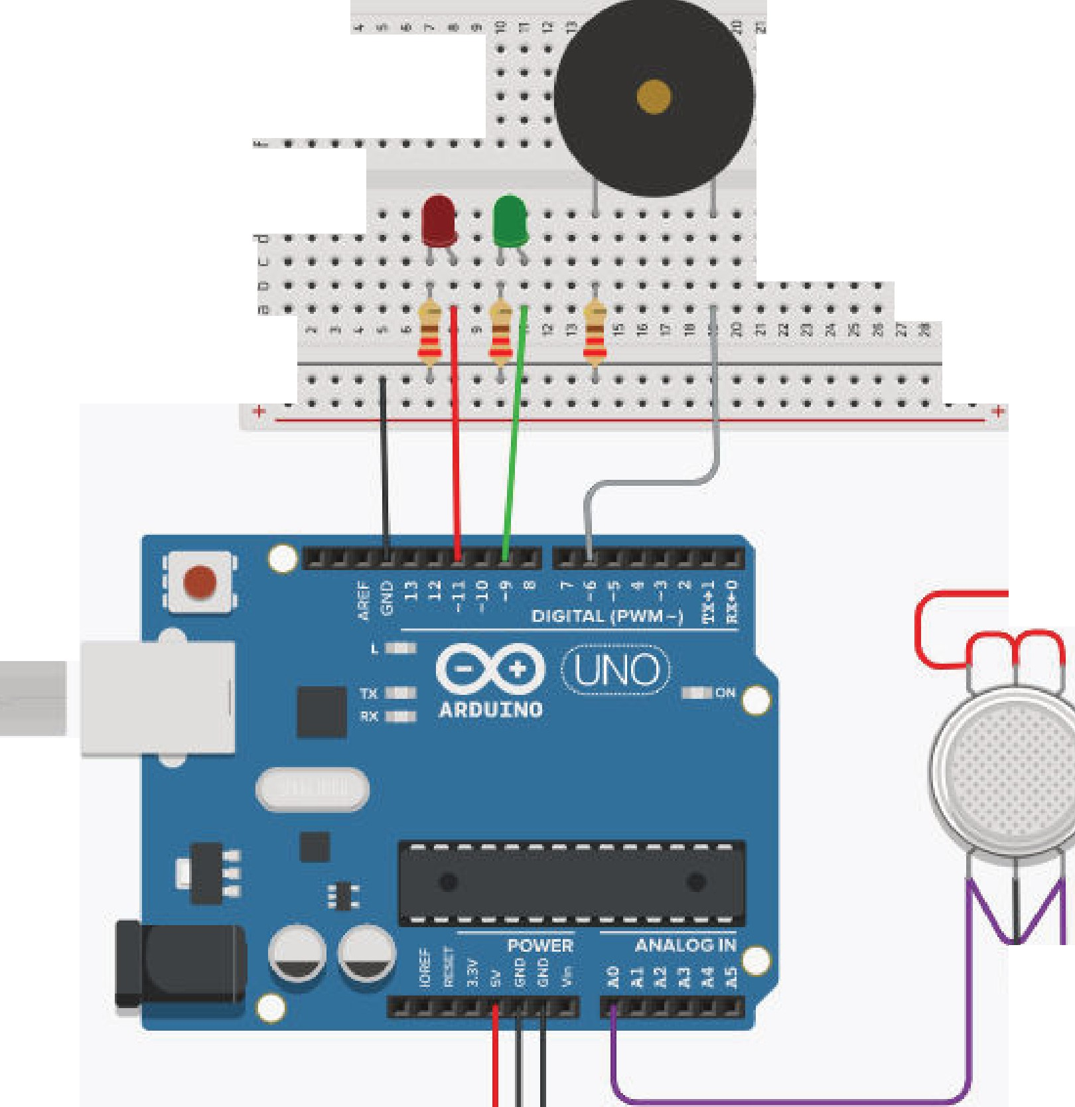


...........................• t. • I •
• • •. .. •.•. •.
+
.
- -
+
·- .........
,J: • •
.. .. .. . .
• •
• .. • • rll
• !I! E.
C> .
• • • •
• • • • •
""
• I • .._
... ' ....' ..
.' .."'
. ...
ti: .. . i •
i • ,.
..:. .
u
• • • • I • • I • I
I • I • • I
• D
• • ..
r'D
l!l a
"'
Schematic of Smoke Detector
ISchematic of Smoke Detector

Slide 5
...........................• t. • I •
• • •. .. •.•. •.
+
.
- -
+
·- .........
,J: • •
.. .. .. . .
• •
• .. • • rll
• !I! E.
C> .
• • • •
• • • • •
""
• I • .._
... ' ....' ..
.' .."'
. ...
ti: .. . i •
i • ,.
..:. .
u
• • • • I • • I • I
I • I • • I
• D
• • .. r'D
l!l a
"'

